Slide 1



Team No. 18
Created By:
21DCE003 Param Bavarva
21DCE034 Vatsal Jajadiya
21DCE035 Arpan Jamod

Slide 2
CONTENTS
1. Introduction, Background Theory, and Problem Statement. 2. Current System and its limitations. 3. Proposed System and Scope of the System. 4. Requirement Gathering Techniques Used. 5. Hardware and Software Requirements. 6. Project Definition and Planning. 7. Implementation Details. 8. Snapshots of your system. 9. Activity Diagram. 10. Limitations and Future Scope. 11. Conclusion. 12. References.

Slide 3
Introduction
OfficeHub is website which works on smart office management system.
The presentation will cover an Overview of Office Management System, which is a software application designed to store, organize, manage, and track digital documents and their associated metadata. The purpose of the presentation is to highlight the limitations of the current system, introduce the proposed system, and demonstrate how the new system will overcome these limitations.

Slide 4
Background Theory and Problem Statement
Office Hub provide a centralized location for storing and organizing all types of documents, including text documents, spreadsheets, presentations, images, Pdfs and videos. These systems allow authorized users to access documents from anywhere, at any time, using any device with an internet connection. Office Hub also enable organizations to track the document's history.
The importance of document management systems for offices is significant. Office Hub can help organizations save time and money by reducing manual processes.

Slide 5
Current System and its limitations
The current system for document management in many offices often involves a combination of manual processes and file storage systems like network drives or shared folders. This system has several limitations and can result in several problems, such as:
Difficulty in locating documents.
Limited access.
Security concerns.
Lack of collaboration.
Inefficient workflows.

Slide 6
Proposed System and Scope of the System
A Office Hub is a software solution that enables organizations to store, manage, and track electronic documents and files. The proposed Office Hub is a system that allows users to store, share, collaborate, and manage digital documents and files within an organization.
The scope of the proposed Office Hub includes the following features:
Document Storage
Document Sharing
Team Creation
Document Workflow Management
Project Workflow Management
Chat with Team
Security and Access Control

Slide 7
Implementation Details
► The implementation details of a proposed Office Hub will depend on a variety of factors, such as the specific requirements of the organization, the chosen technology stack, and the available resources. However, here are some general implementation details that may be involved:
1. System design:
This will involve creating a system architecture that is scalable, secure, and efficient, as well as designing the user interface and other user-facing components of the system.
2. Development:
Once the system design has been created, the development team will begin building the system. This will involve creating the back-end database and application logic, as well as developing the front-end user interface.

Slide 8
Continue…
3. Testing:
Once the system has been developed, it will need to be thoroughly tested to ensure that it meets the requirements and is functioning as expected.
4. Deployment:
Once the system has been tested and approved for release, it will be deployed to the production environment.
5. Training:
Once the system has been deployed, users will need to be trained on how to use it effectively.
6. Maintenance:
This will involve monitoring the system for issues, applying patches and updates, and making changes as necessary to meet changing business requirements.

Slide 9
A TIMELINE ALWAYS WORKS WELL
JANUARY
MARCH
FEBRUARY
LEARN AND IMPLEMENT
IMPLEMENT AND CHANGES
LEARN

Slide 10
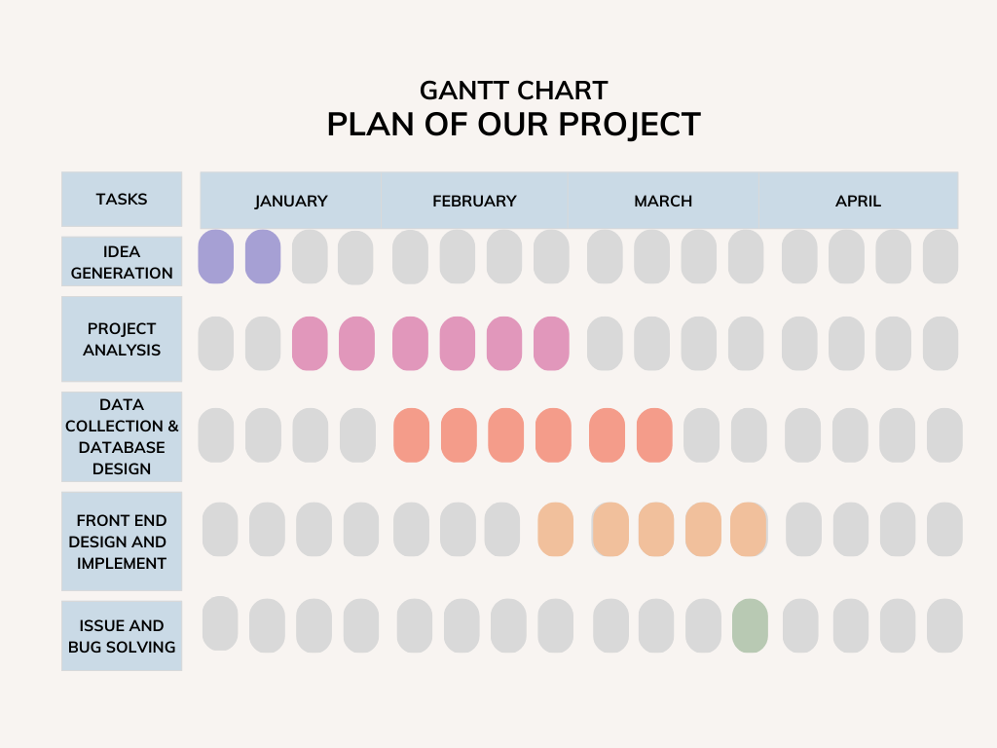
Gantt chart

Slide 11
Hardware and Software Requirements
Processor
RAM
Hard Disk
Updated Browser Like Chrome For Running on Localhost
Intel x86 64-bit chip architecture, 12 CPU, cores at 2Ghz.
Minimum 4 GB.
Minimum 2 GB.
Code Editor Like VS Code
Mongodb Compass For DataBase

Slide 12

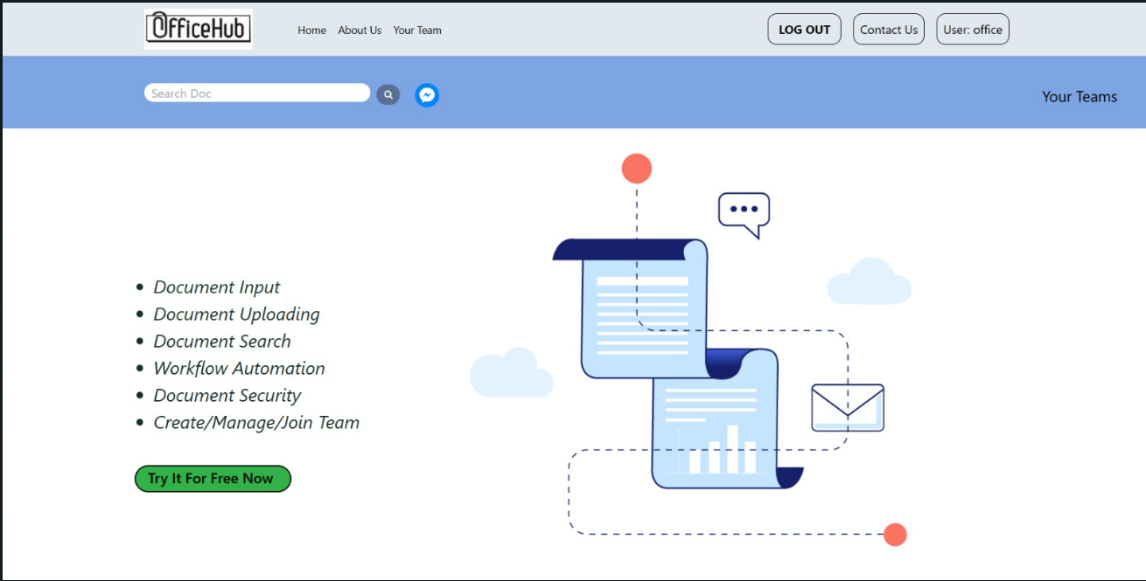
SNAPSHOTS
That is snapshot of our home page of website.

Slide 13

Scope of System
For many years, paper documents were used to store information. However, papers can be expensive and are wasteful as well. On the other hand, Office Hub can solve this paper issue by letting users access, track, and edit information stored in the document. Office Hub is a type of electronic cabinet that is used to store and organize paper and digital files.

Slide 14
Limitations of System:
As everything is in digital form, there’s a possibility that the information might land in the wrong hands.
Office Hub saves the environment by going paperless, but for that, a massive amount of data must be scanned, and for that, you need expensive hardware components and Higher Storage Requirements.
Smaller businesses may find it challenging to cope with, so a higher level of IT involvement is required.

Slide 15
CONCLUSION
Using Office Hub systems effectively within an organization ensures that data and knowledge is safe, accurate, and accessible. With that comfort, employees feel more apt to reduce paper and rely on the Office Hub system. It is one important step to becoming a paperless office.

Slide 16
RESOURCES
https://www.viennaadvantage.com/blog/business-hacks/8-features-every-document-management-system-Office Hub-must-have/
https://www.folderit.com/?gclid=CjwKCAiAr4GgBhBFEiwAgwORraEY7e6VyuRTI9NJDyPnirR_VQUJ6kpyTUPpA3uZ8O_aGXbwEto-OxoCIGcQAvD_BwE

Slide 17
THANKS!

